Slide 1


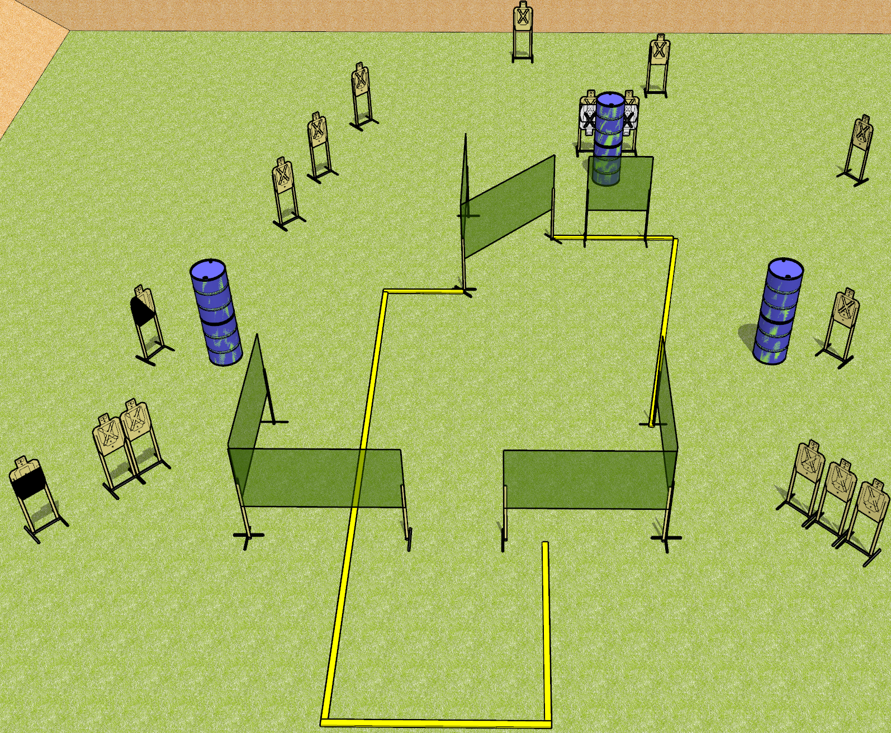
 | Dothan Gun Club – USPSA Match So Much To Do Course Designer : Drew Coleman
START POSITION : Standing anywhere outside the shooting are, wrists below belt
GUN READY CONDITION : Pistol loaded and holstered. PCC loaded, held with both hands, buttstock on belt, safety on. |  | SCORING: Comstock, 32 rounds TARGETS: 16 paper, 0 Steel SCORED HITS: Best 2 on paper, steel until down START-STOP: Audible, last shot RULES:
STAGE PROCEDURE: Engage targets as they become available from within the fault lines.

Slide 2
So Much To Do
Written Stage Briefing
So Much To Do is a 32 round, 160 point, Comstock field course. There are sixteen USPSA targets. The best two hits on paper will score. The start signal is audible.
Handgun start position is standing anywhere outside the shooting area, wrists below belt. Handgun is loaded and holstered.
PCC start position is standing anywhere outside the shooting area. Loaded carbine is held with both hands, safety on, buttstock on belt.
On start signal, engage targets as they become available from within the shooting area.

